Slide 1
ANGULAR 9 INTRODUCTION

Slide 2
INTRODUCTION
Angular is Client Side JavaScript Framework.
It allows you to create modern Single Page Applications.
Released In 2020.
Developed and maintained by Google.
We can build large scale and high performance web applications.
In built services and plug-in which is used for develop web app.

Slide 3
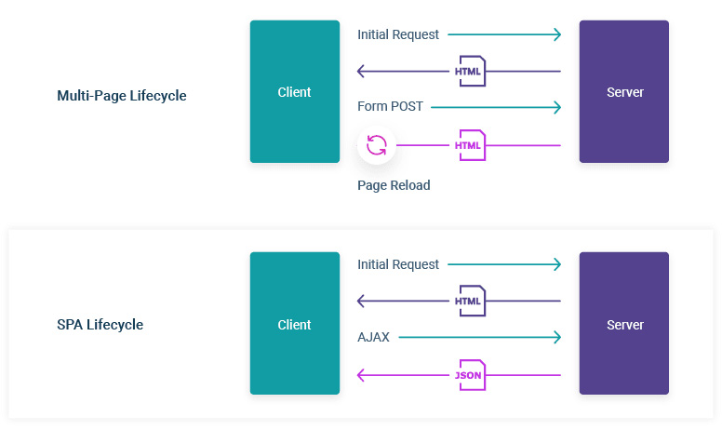
What is Single Page Application
Loads a single HTML page and dynamically update that Page.
After the first page loads, all interactions with the server happens through AJAX calls.
AJAX request to the server and the server will send the data in the JSON format to the browser then javascript will update the browser without reloading the Page.
AJAX -- Asynchronous Javascript And XML
JSON – Javascript Object Notation
Ex:- Gmail, Facebook etc...

Slide 4
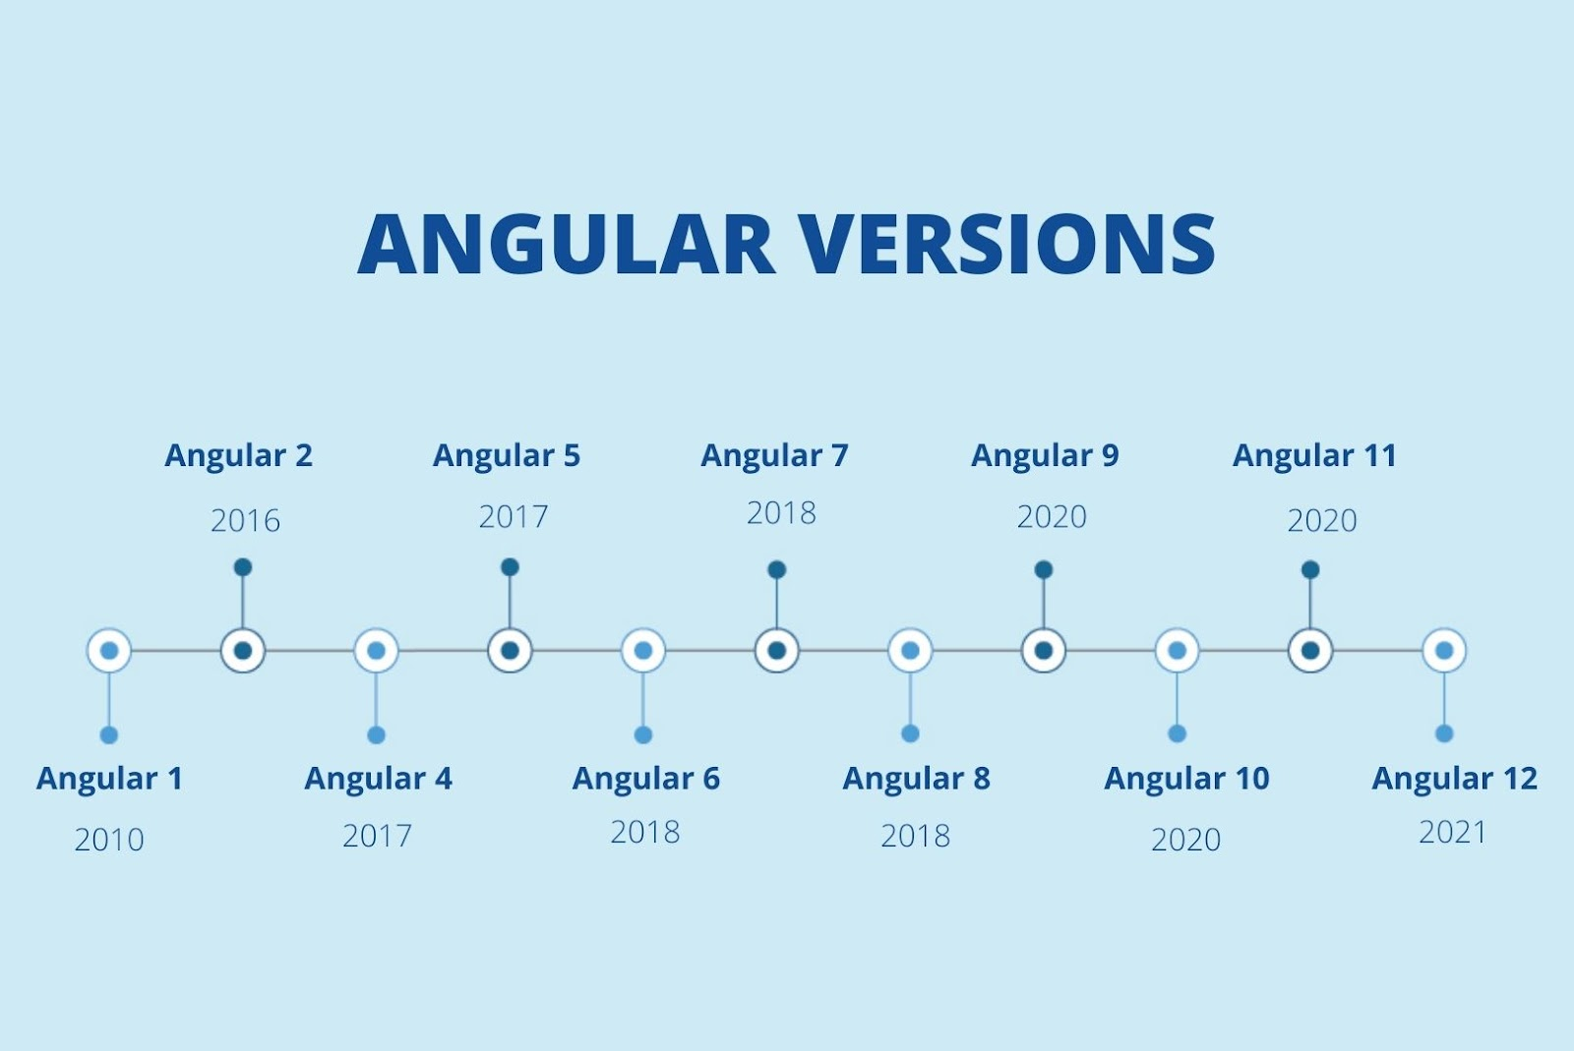
VERSION
Angular version numbers indicate the level of changes that are introduces by the release. This use of semantic versioning helps you understand the potential impact of updating to a new version.
Angular version numbers have three parts: Major.Minor.Patch.
For Example:- Version 7.2.11 indicates major version 7, minor version 2, and patch level 11.
Latest Angular version is Angular 14.0.0 released in 02-06-2022.

Slide 5
FEATURES
Cross Platform.
Progressive Web Apps.
Use modern web platform capabilities to deliver app-like experiences. ...
Speed and Performance.
Code Generation. ...
Templates
Testing

Slide 6
ADVANTAGES
Typescript allows code optimization using OOPs concepts.
It is mobile oriented.
It has imporoved dependency injection and modularity.
It provides more choice for language such as Typescript, ES5 and ES6 writing codes.
It offers simple Routing.

Slide 7




PREREQUISITES
HTML
CSS
JAVASCRIPT
TYPESCRIPT

Slide 8
ENVIRONMENTAL SETUP
Step 1:- Install Nodejs, npm.
sudo apt install nodejs
Verify the installation of nodejs by usingthe command,
node -v
Step 2:- Install Angular CLI.
npm install -g @angular/cli

Slide 9
ENVIRONMENTAL SETUP
Step 3:- Create a new project,
ng new <app_name>
app_name --> your project name
Step 4:- Naviagate to project folder and start the application.
ng serve --open

Slide 10
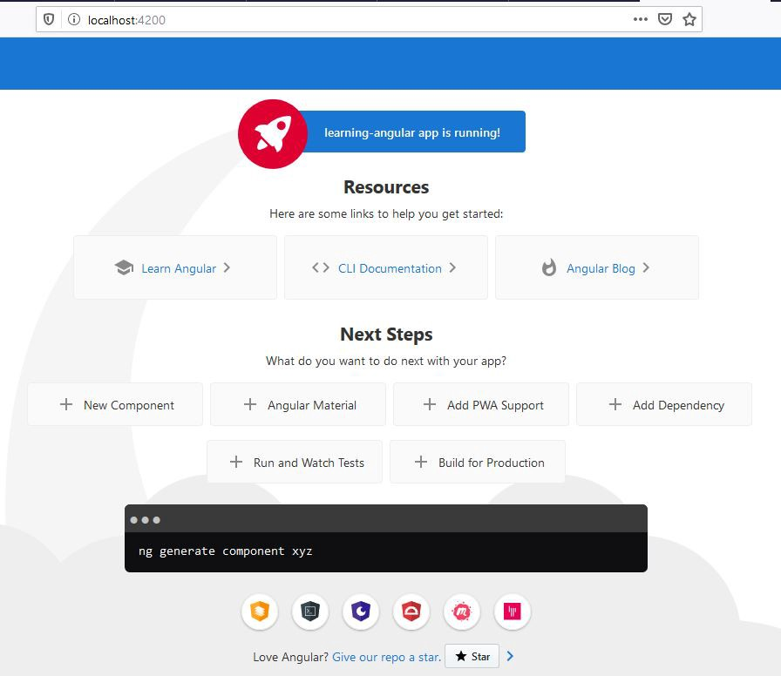
APPLICATION DEFAULT OUTPUT

Slide 11



IDE FOR ANGULAR
IDE (Integrated Development Environment) is a program that simplifies the effort required by developers by optimizing the entire development process and help you in writing flawless code. It helps in integrating the software into the system and analyze the working.
1. Visual Studio Code ( VS Code)
2. Webstorm
3. Sublime Text

Slide 12
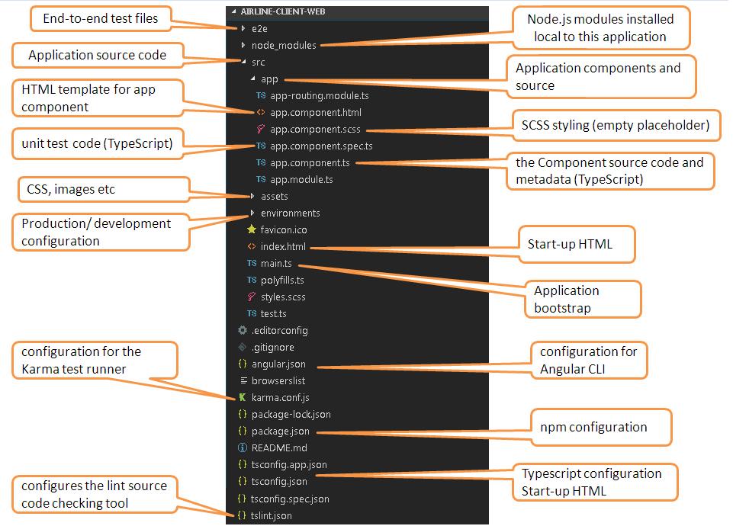
About Angular Application
Every Angular Application has atleast one module.
Every Angular Application having Root Module which is called as App Module.
Every module contains components, services, directives, pipes and other.
Every component is a combination of HTML+CSS+TYPESCRIPT.
Every Services contains business logic.
Main.ts :- It is an entry point for Angular application which will kick start app.module.ts.
App.module.ts :- It is a root module which will kick start the app.component.ts and then app.component.html.

Slide 13
About Angular Application
In app.component.ts there will be selector.
Bydefault the selector contains app-root.
In index.html the body contains the app-root.
When the component renders the only Index.html will load and display the output in the browser.
For Generating a Custom Module
ng generate module name of the module
Ex:- ng g m main
For Generating a component
ng generate component name of the component
Ex:- ng g c home

Slide 14
FILE STRUCTURE
app/app.component.html:- Defines the HTML template associated with the root AppComponent.
app/app.component.css :- Defines the CSS stylesheet for the AppComponent.
app/app.component.ts :- Defines the logic for the application’s root component, named AppComponent.The view associated with this root component becomes the root of the view hierarchy as you add components and services to your application.
app/app.component.spec.ts :- Defines the unit testing for the AppComponent.

Slide 15
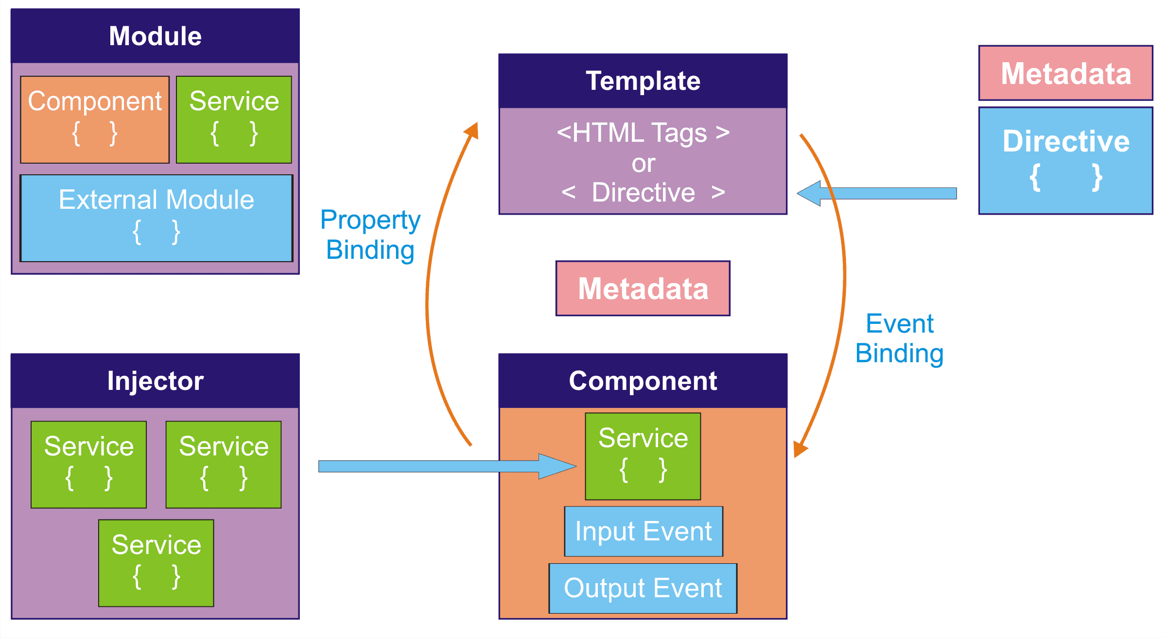
Angular Architecture

Slide 16

BOOTSTRAP
Bootstrap is a potent front-end framework used to create modern websites and web apps.
A Bootstrap theme is a package containing CSS, HTML and JAVASCRIPT code used for styling.
Bootstrap themes also feature various UI components ad page layouts can be employed to create websites.

Slide 17
BOOTSTRAP
Import Bootstrap by adding the CDN into your base index.html file.
CSS :-
<link href="https://cdn.jsdelivr.net/npm/bootstrap@5.1.3/dist/css/bootstrap.min.css" rel="stylesheet">
JS :-
<script src="https://cdn.jsdelivr.net/npm/bootstrap@5.1.3/dist/js/bootstrap.bundle.min.js"></script>

Slide 18
Thank you
Presented By
Monica.R
Patnana Santosh Kumar

